Slide 1
Web Traffic Analysis
Ritvik - Dhupkar

Slide 2
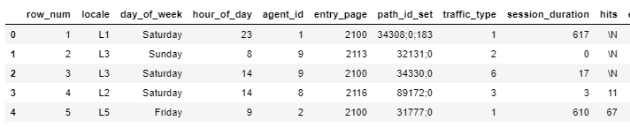
Objectives
Impute missing data for the missing ‘hits rows’
*Web_traffic_analysis_CatBoost_FINAL.ipynb: final CatBoost model (use for evaluation)
randomforest-and-eda.ipynb : RandomForest model and EDA

Slide 3
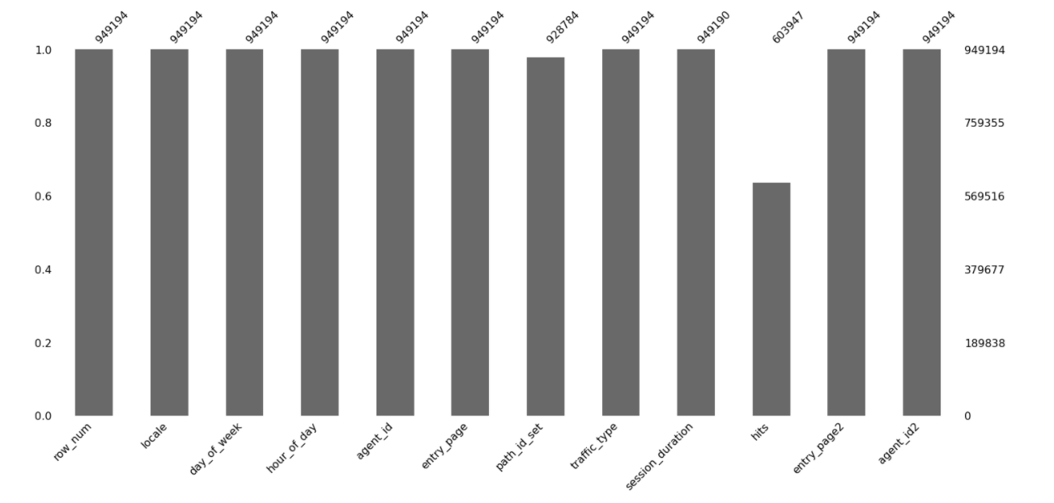
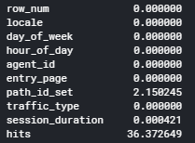
Insights on Missing Data
36% of hits data and 2% of session_duration data is missing
Missing Data Percentage Across Columns

Slide 4
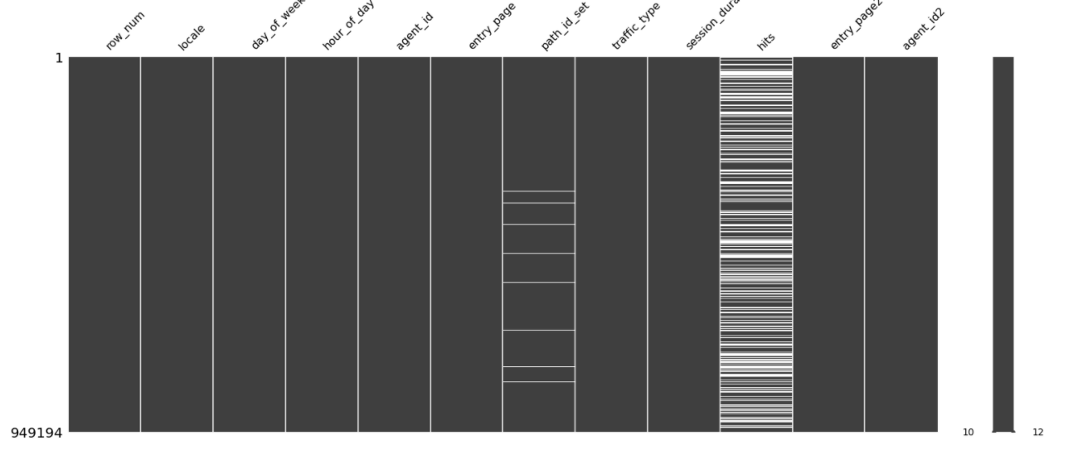
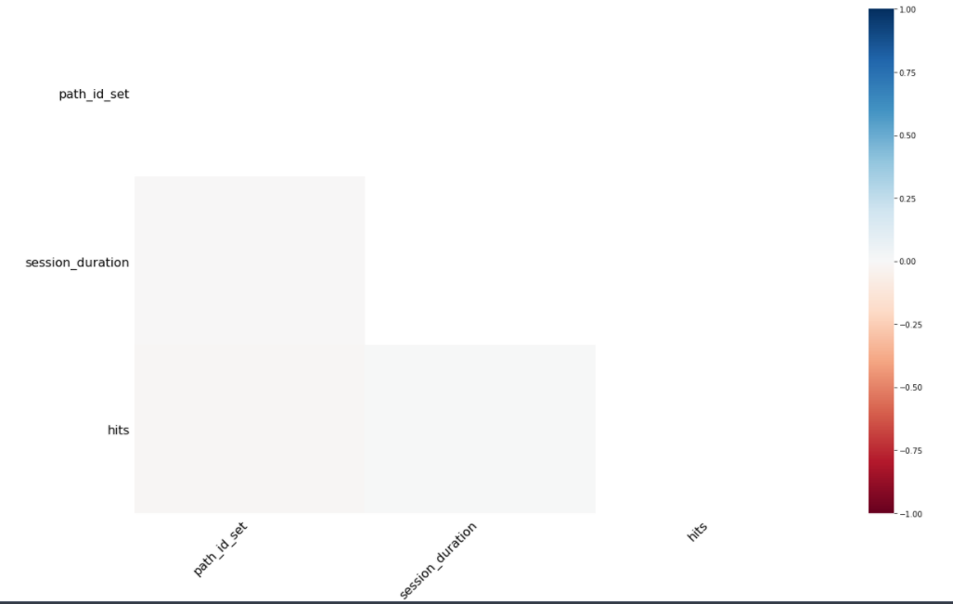
Insights on Missing Data
The missing data is randomly distributed across the domain and there is no correlation
in missing Data between columns
Missing Data distribution across columns
No correlation of missing Data across columns

Slide 5
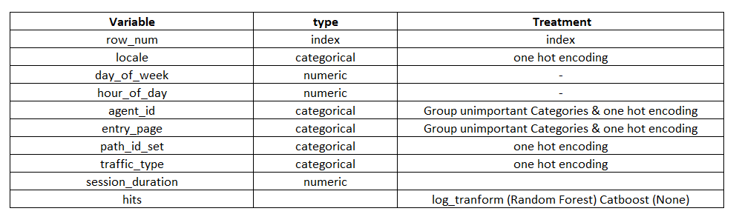
Methodology
Perform Exploratory Data Analysis to understand Factors affecting Hits
Extract features from Web Traffic Information like locale, traffic type, etc.
Clean categorical features: Group low frequency categories of the columns agent_id and entry_page into the new category ‘999’
Perform One-Hot-Encoding on categorical features
Transform hits and session_duration using log-transform (for Random Forest only) and box-cox transform respectively
Train a Regression Tree Models to Predict the missing values of ‘hits’. The Random Forest Model and Catboost model are used
List of Features

Slide 6
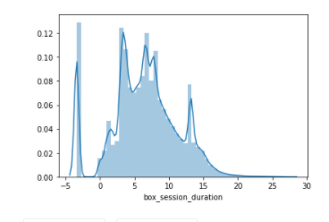
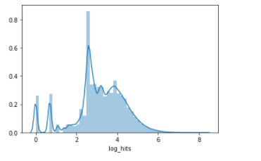
Exploratory Data Analysis on Factors affecting Hits
Box-cox Transformation on session duration
Log Transformation on hits
The Session Duration and hits are heavily right tailed, so a box-cox transformation (session_duration) and a log transformation (hits) is applied on them to normalize them,

Slide 7
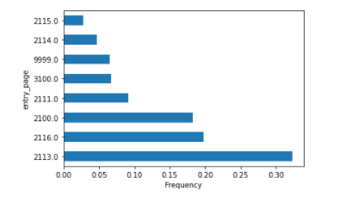
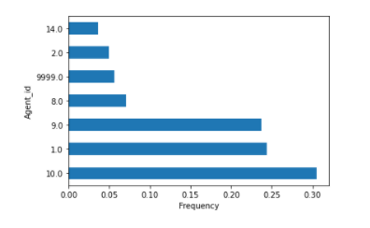
Transforming categorical variables
entry_page vs frequency
Agent_id vs frequency
The top 6 most frequently occurring agent_ids and top 7 most frequent entry_page are maintained as categories
The remaining categories with frequency of 5% are grouped together and labeled ‘999’

Slide 8
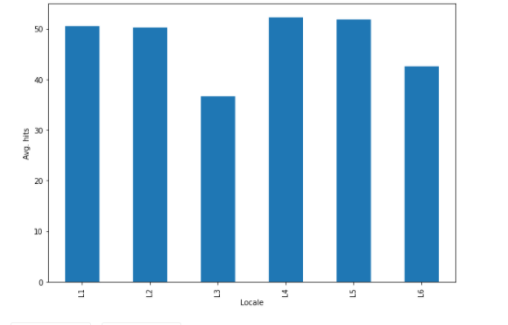
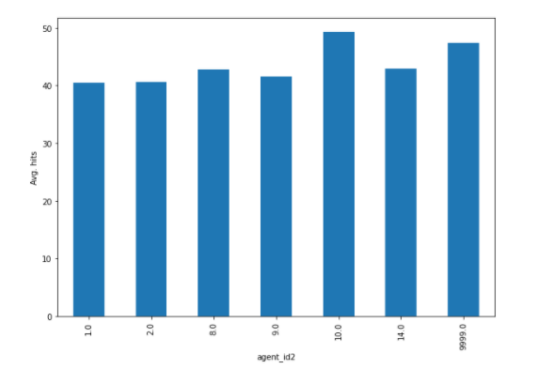
Bi-Variate Analysis on hits
Avg. hits vs Locale
Avg. hits vs agent_id
Locale L3 has a significantly lower avg. hits than others
Avg. hits are similar across agent ids
Bottom 5% of least frequently occurring agent ids are grouped together as agent_id = ‘999’

Slide 9
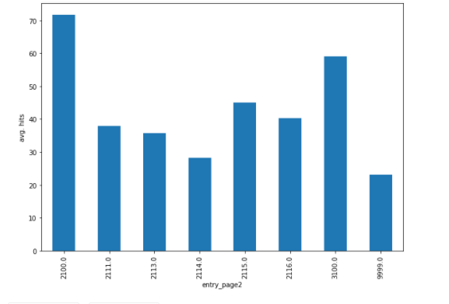
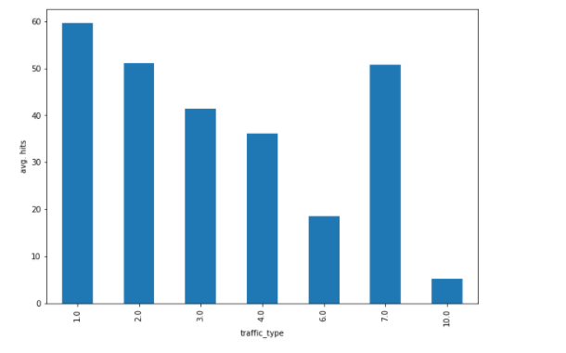
Bi-Variate Analysis on hits
Avg. hits vs entry_page
Avg. hits vs traffic_type
entry_page 2100 has an average hits of 70 while average_hits for other entry pages are lower
Avg. hits differ across traffic types
Bottom 5% of least frequently occurring entry_types are grouped together as entry_type= ‘999’

Slide 10
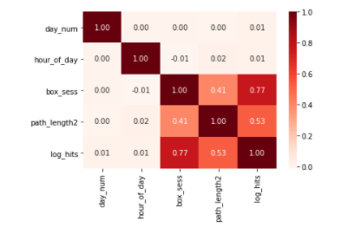
Correlation of continuous variables with log_hits
Box_sess : box_cox transformation of session_duration
Path_length2 : length of path computed from path_id variable (number of destinations visited)
Path_length and session_duration are highly correlated with log_hits

Slide 11
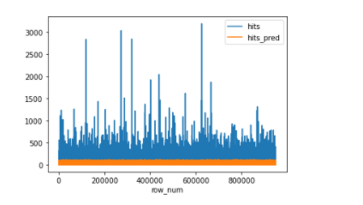
Random Forest model Results
Methodology
Perform transformations on categorical variables
as listed above. One Hot Encoding is performed on
Categorical variables
Transform hits to log_hits. Use log_hits as target variable for training
Take box-cox transform of session_duration
Train the model on available values of hits and perform hyperparameter tuning
Predict the hits on test data with missing values for hits. Take inverse log transform to obtain final predicted values of hits
Validation RMSE = 55.8
hits: Actual values of hits in validation set
Hits_pred: hits predicted by Random Forest model

Slide 12
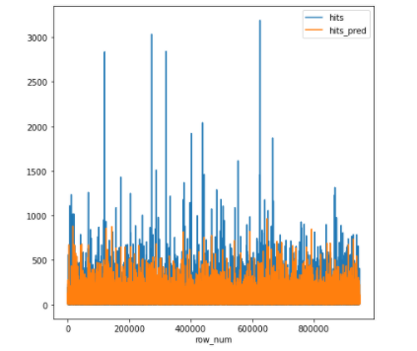
CatBoost model Results
Methodology
From the result plots of the Random Forest, model it
is clear that it fails to effectively model ‘count data’
The CatBoost model with objective =‘Poisson’ is used
to model the data. This uses a poisson loss function
which is used for modelling count data.
One Hot Encoding on categorical variables is performed internally in the CatBoost library
Hits instead of ‘log_hits’ is used as the target variable as a poisson loss function is used
Validation RMSE = 46.4
hits: Actual values of hits in validation set
Hits_pred: hits predicted by CatBoost model

Slide 13
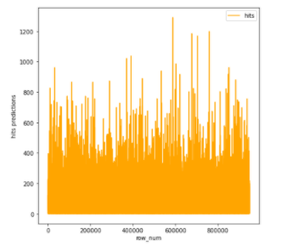
Conclusion
CatBoost model is better able to predict missing platform hits using a poisson loss function
Missing hits: predictions

